Slide 2
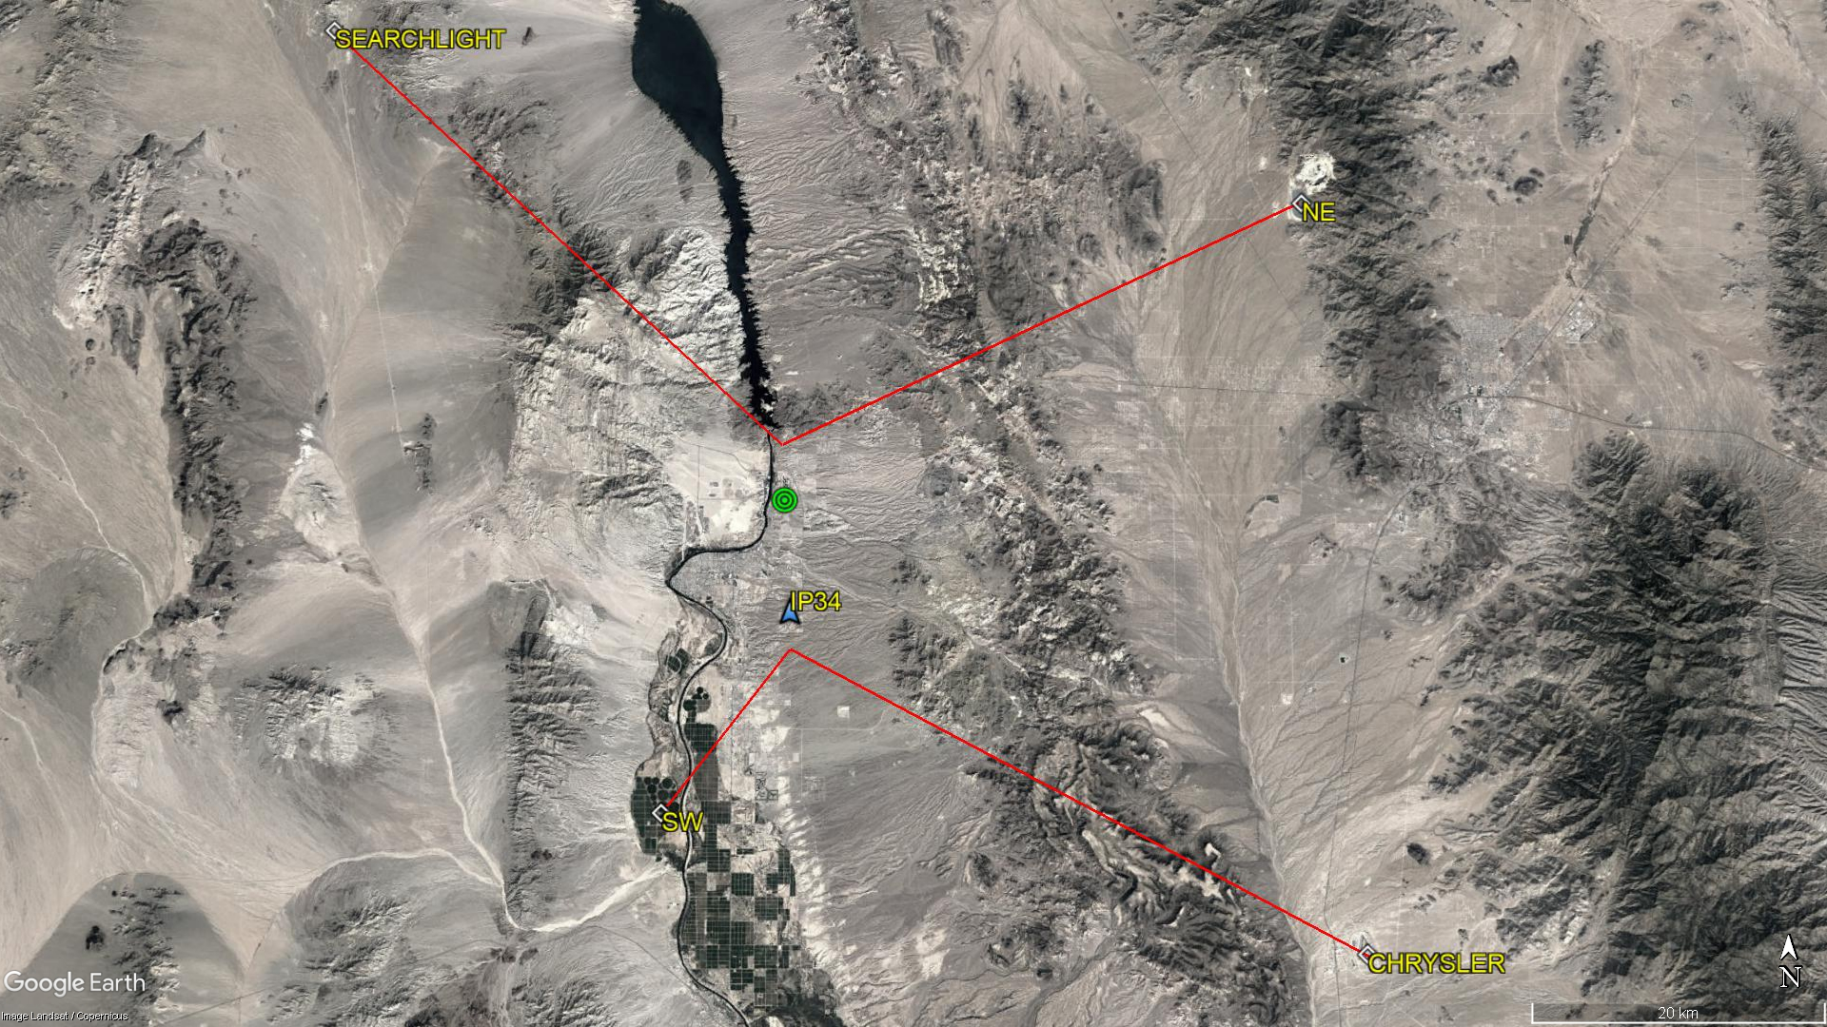
300°
060°
030°
285°

Slide 3
IP34
KIFP
SW

Slide 4
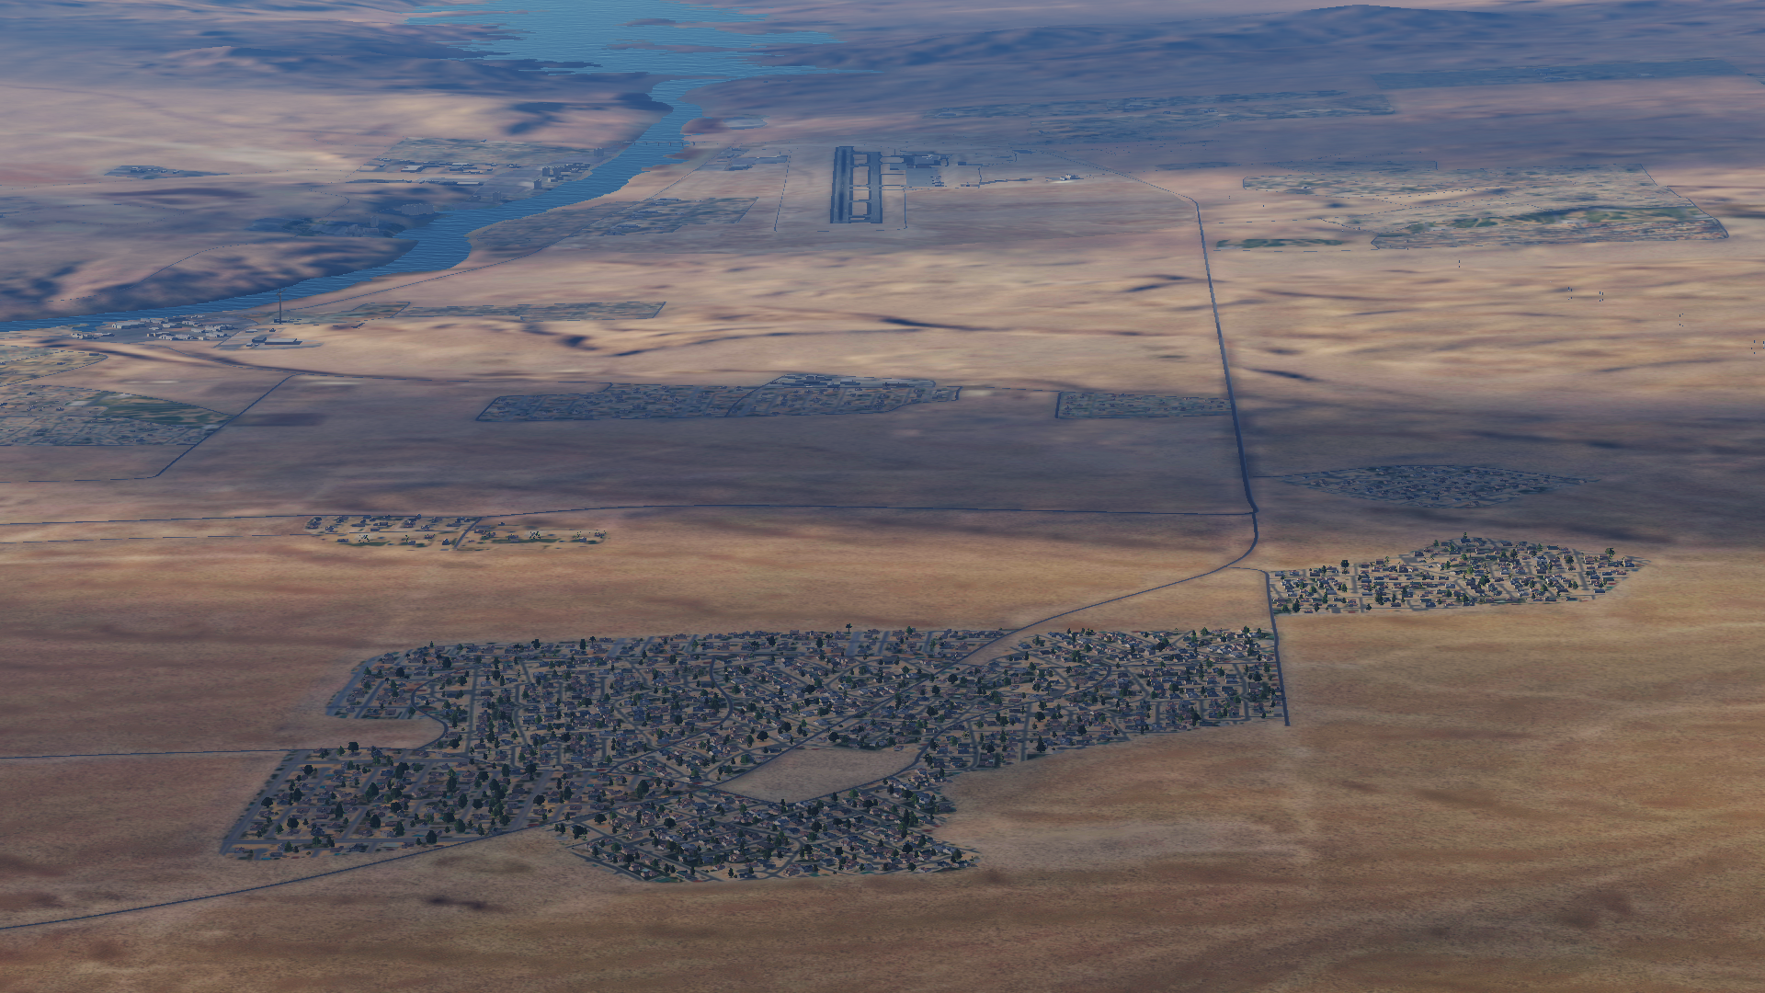
KIFP
IP34

Slide 5
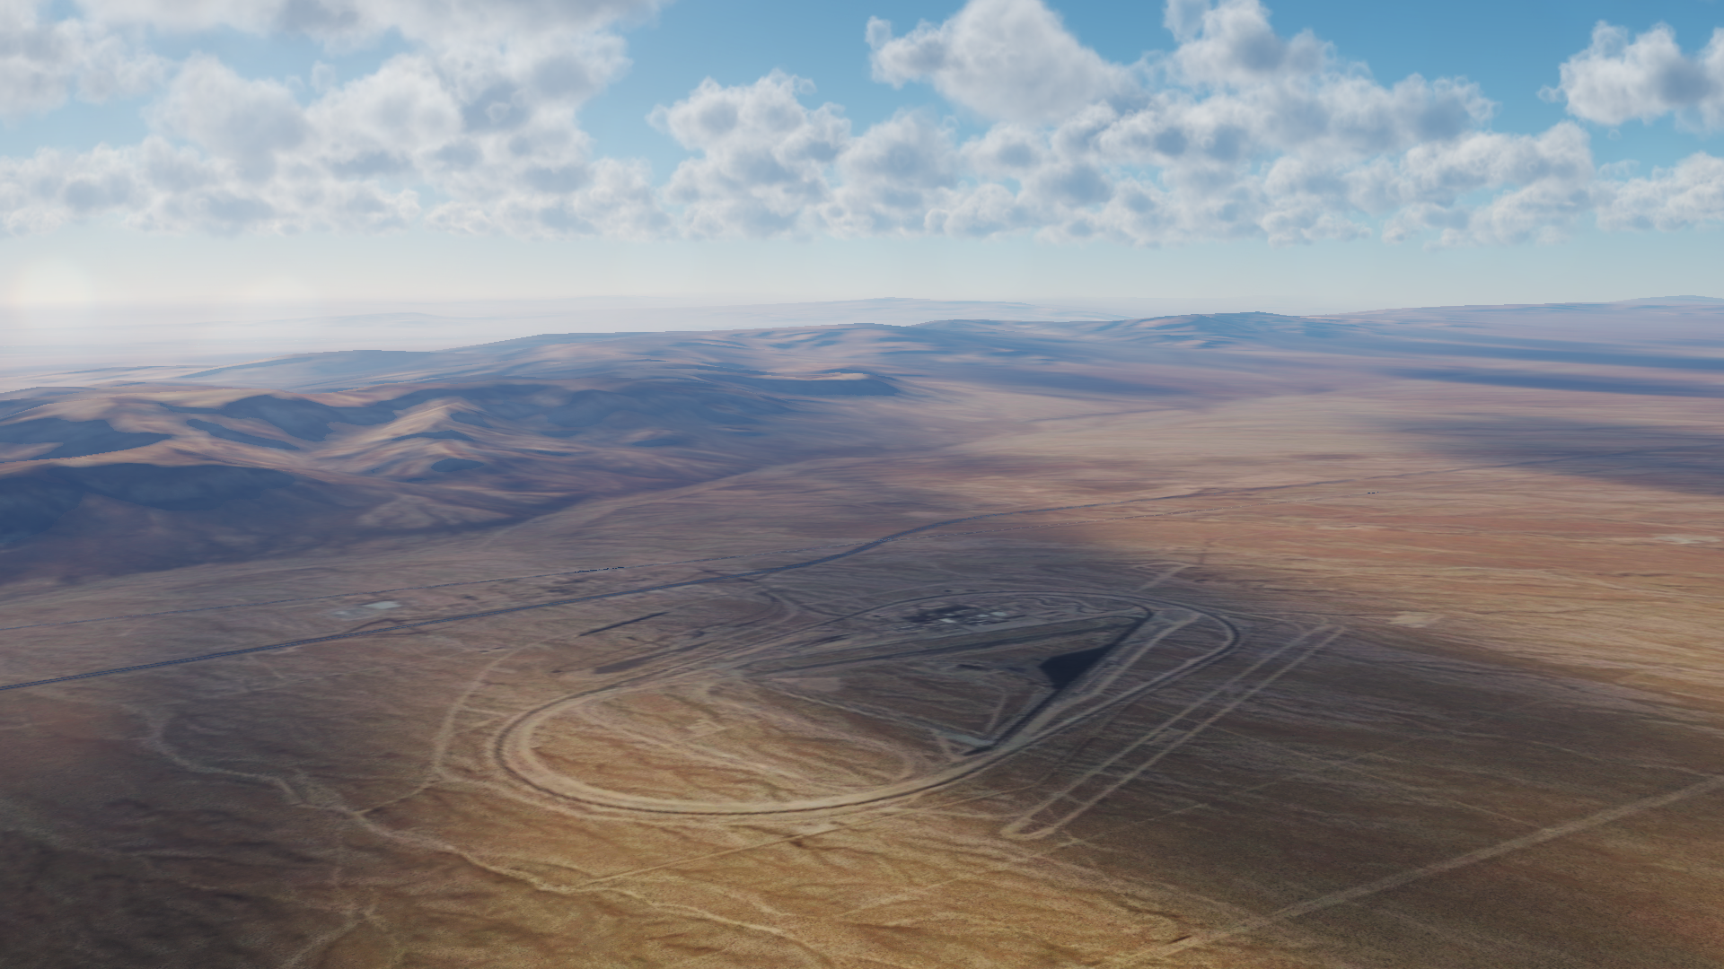
CHRYSLER

Slide 6
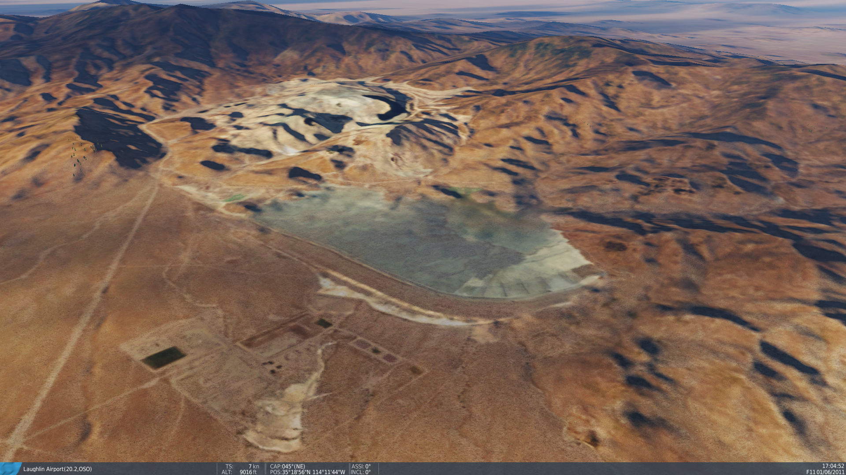
NE

Slide 7
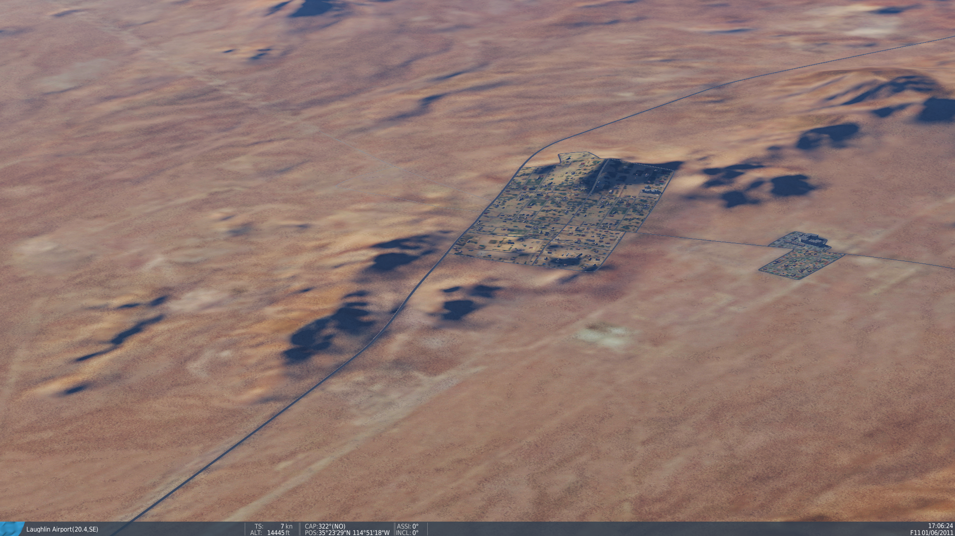
SEARCHLIGHT

Slide 8
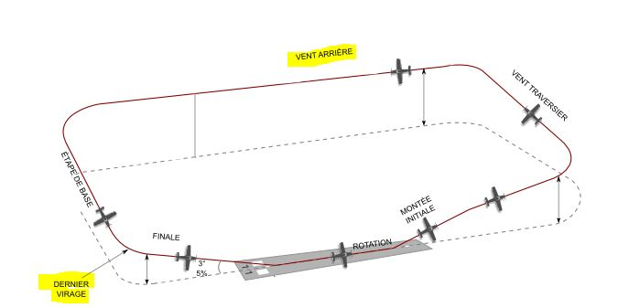
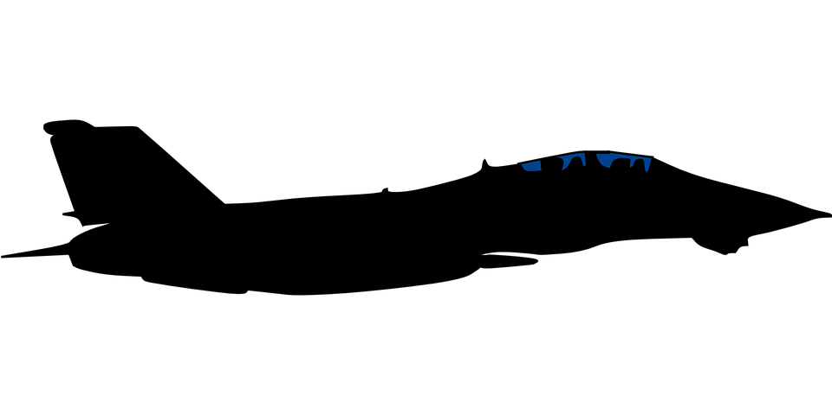
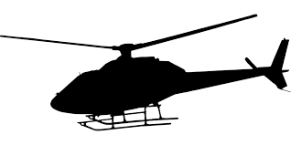
1500ft
1000ft
500ft

Slide 9
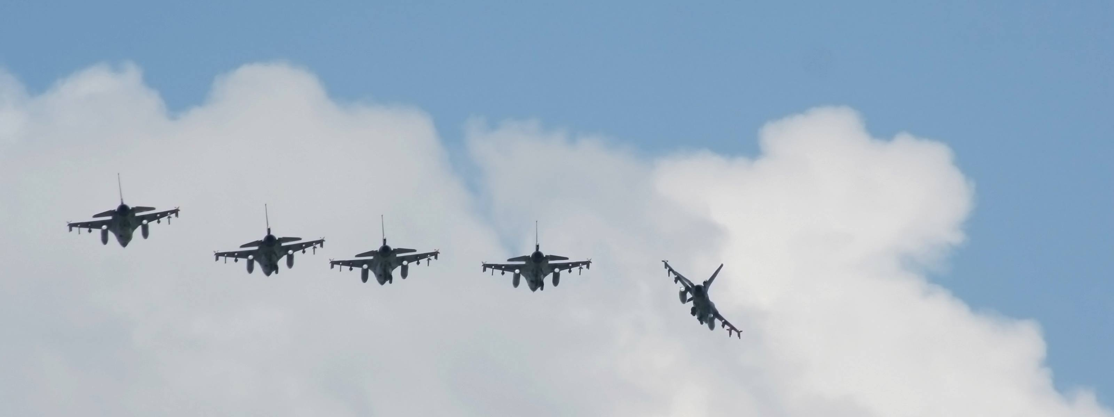
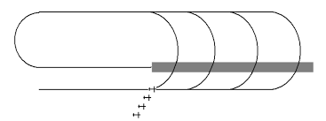
1500ft→ SFC /QFE
IP 2000ft → 1500ft /QFE

Slide 10
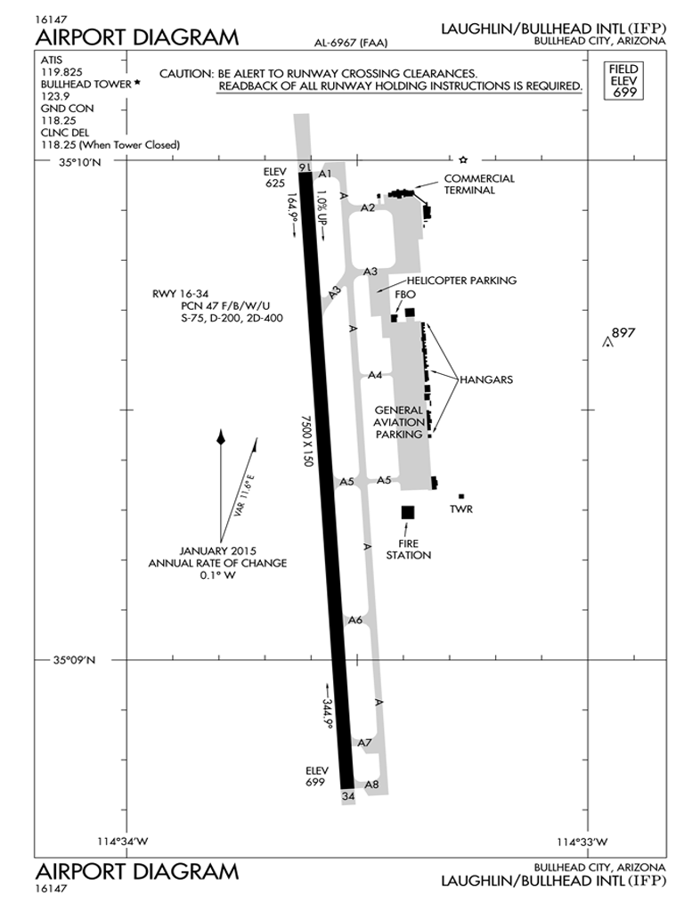

Slide 11
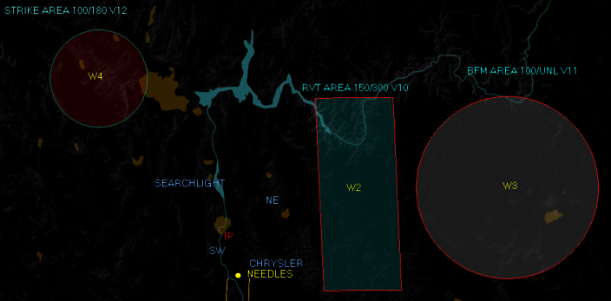
Transport de munitions
Cottonwood

Slide 12
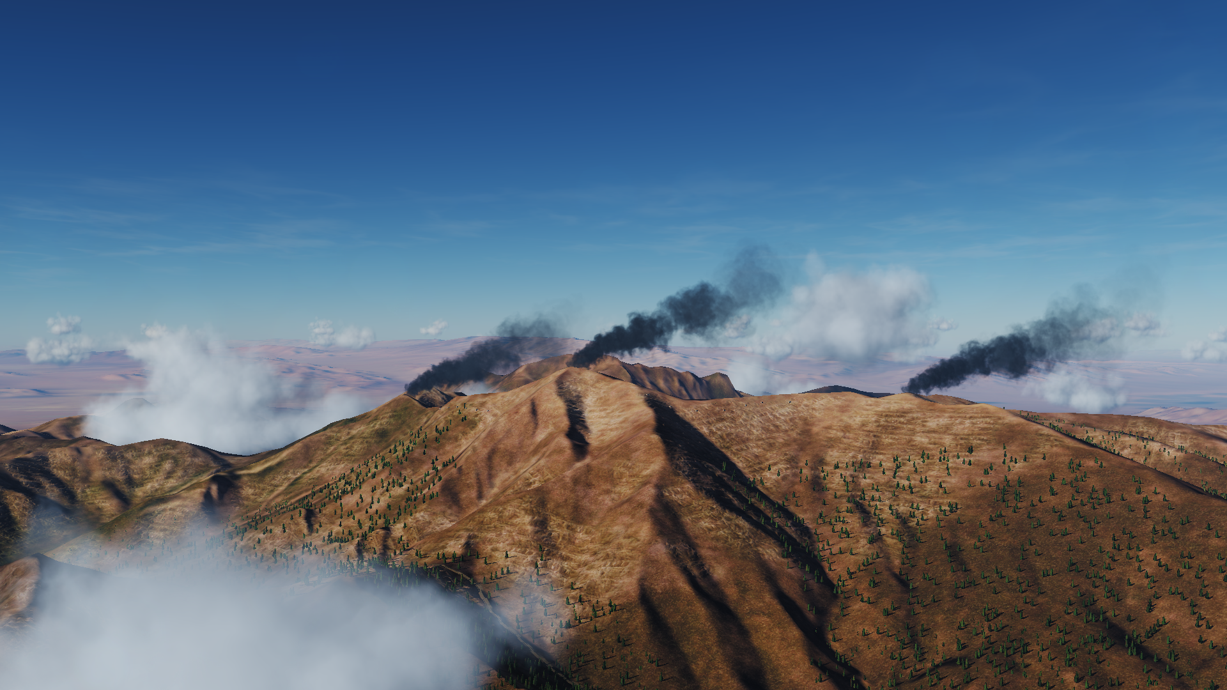
STRIKE

Slide 13
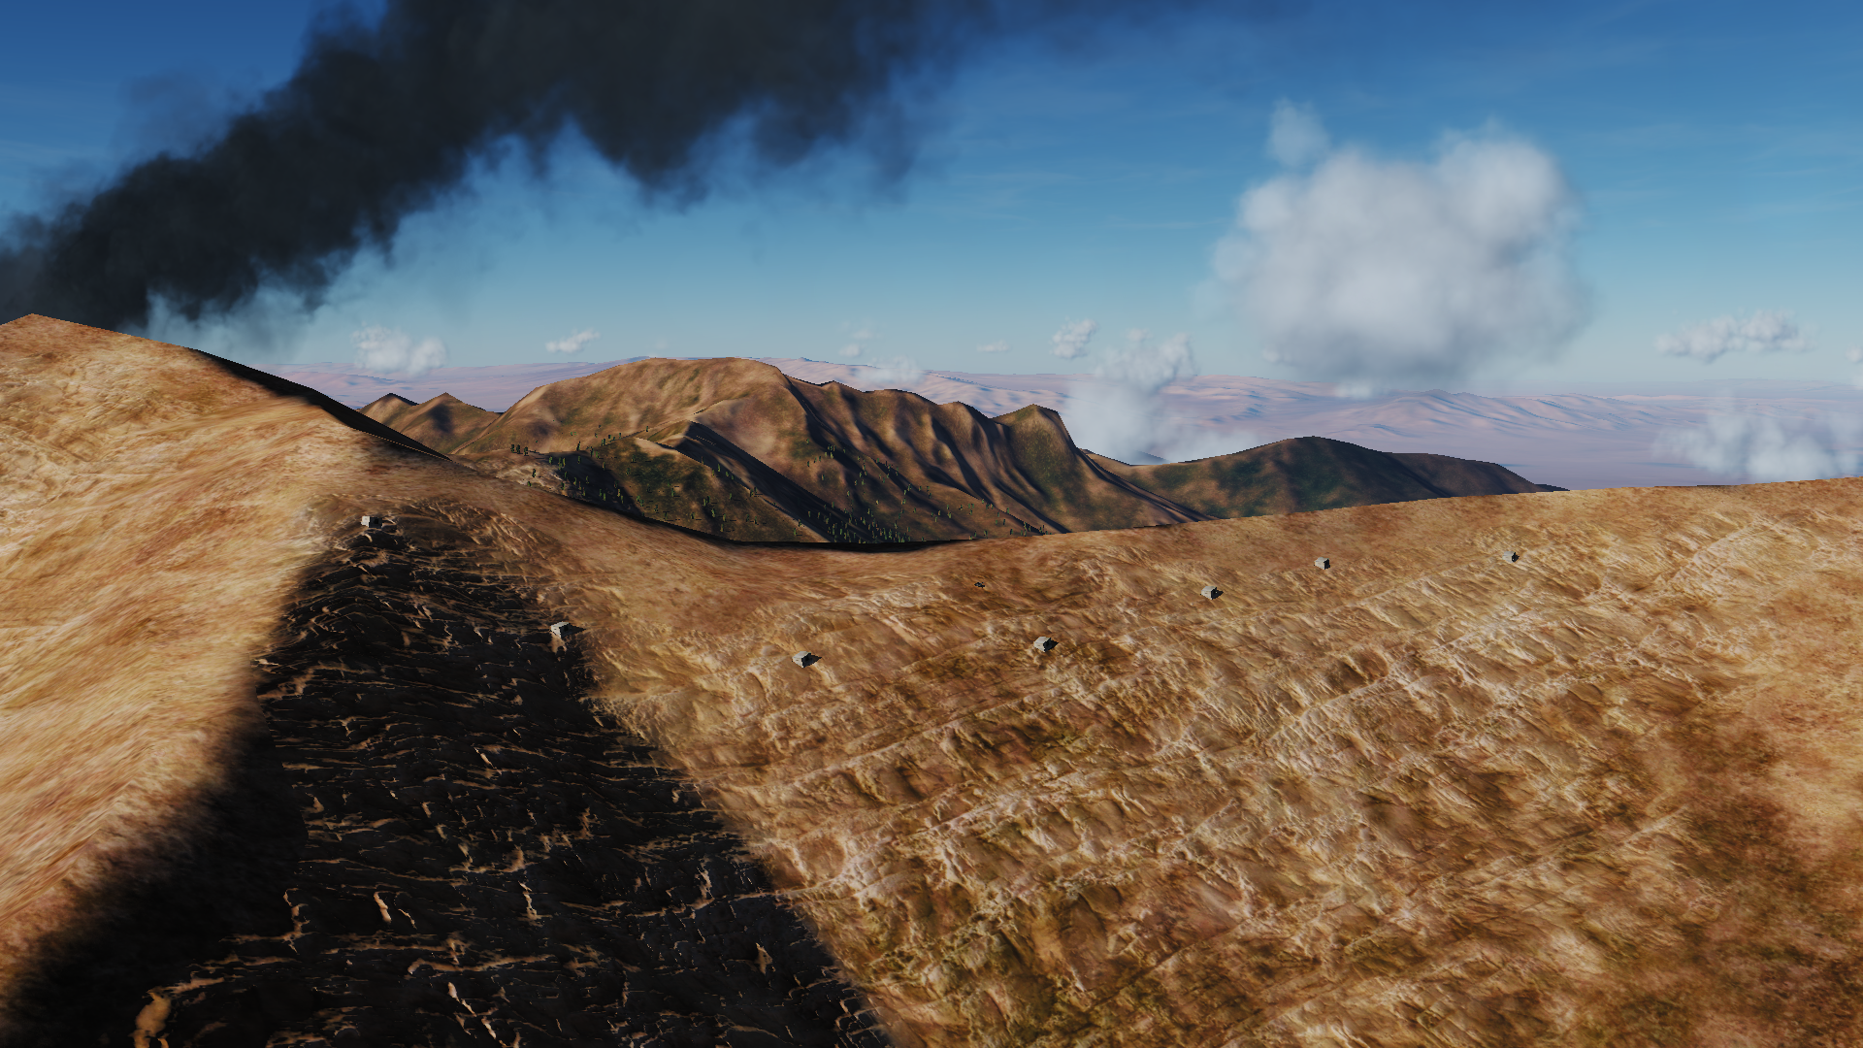

Slide 14
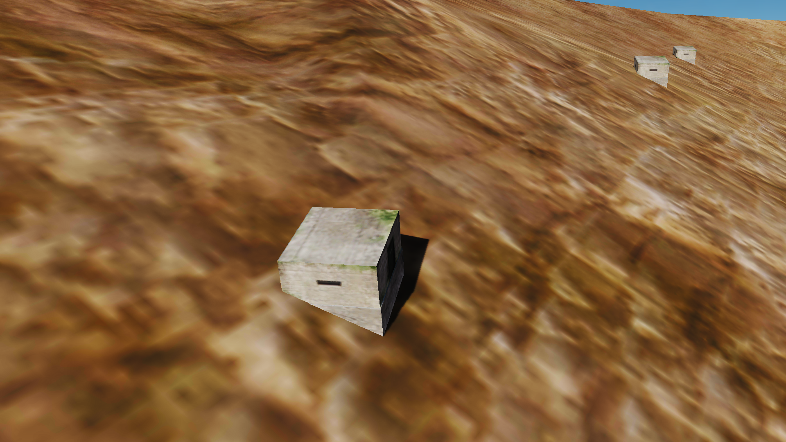

Slide 15
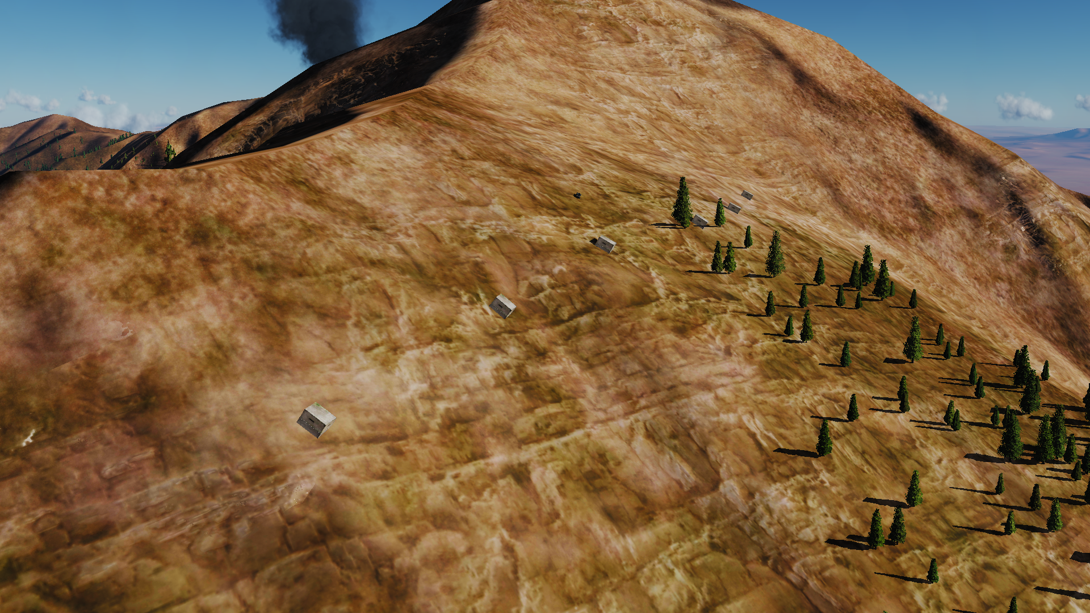

Slide 16
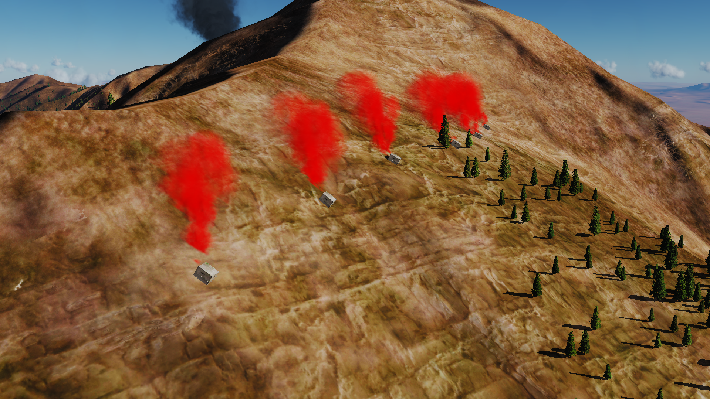

Slide 17
Nav:
W1 : TACAN « NEEDLES »
W2 : RVT AREA
W3 : BFM AREA ( rayon 35NM / 65km )
W4 : STRIKE AREA ( rayon 20NM / 35km )
COMMs :
V01/125.250 : Laughlin Sol
V02/122.300 : Laughlin Tour
V10/120.750 : RVT
V11/138.400 : BFM
V12/134.500 : STRIKE
RVT :
SHELL MPRS 1X
ARCO Drogue 2X
TEXACO BOOM 3X
106 IL78M Drogue

Slide 18
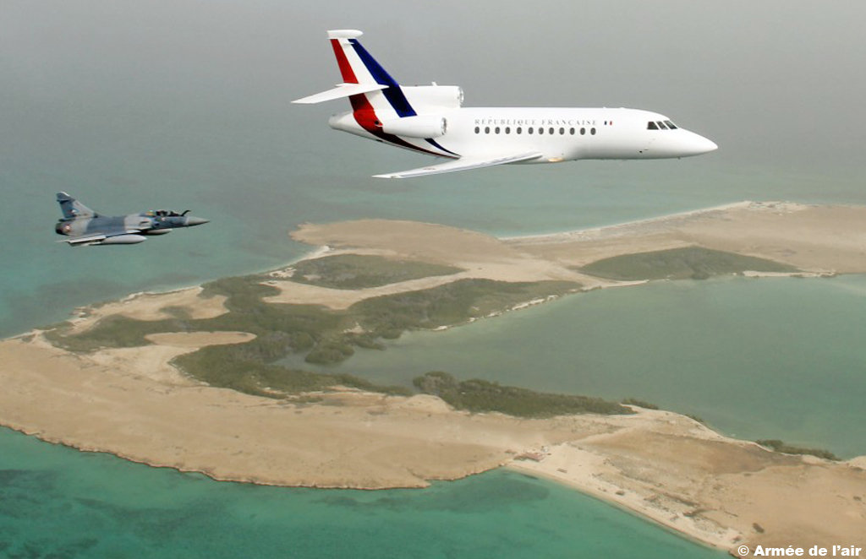
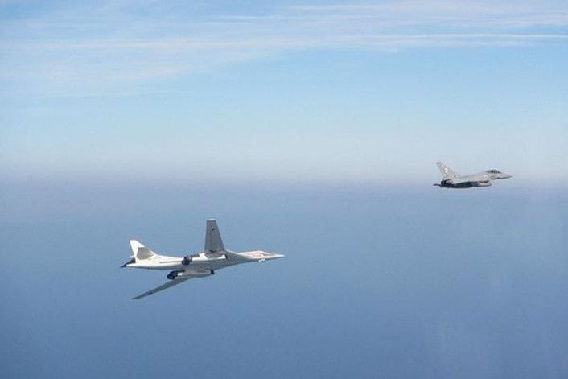
QRA ??

Slide 19
300°
060°
030°
285°

Slide 20
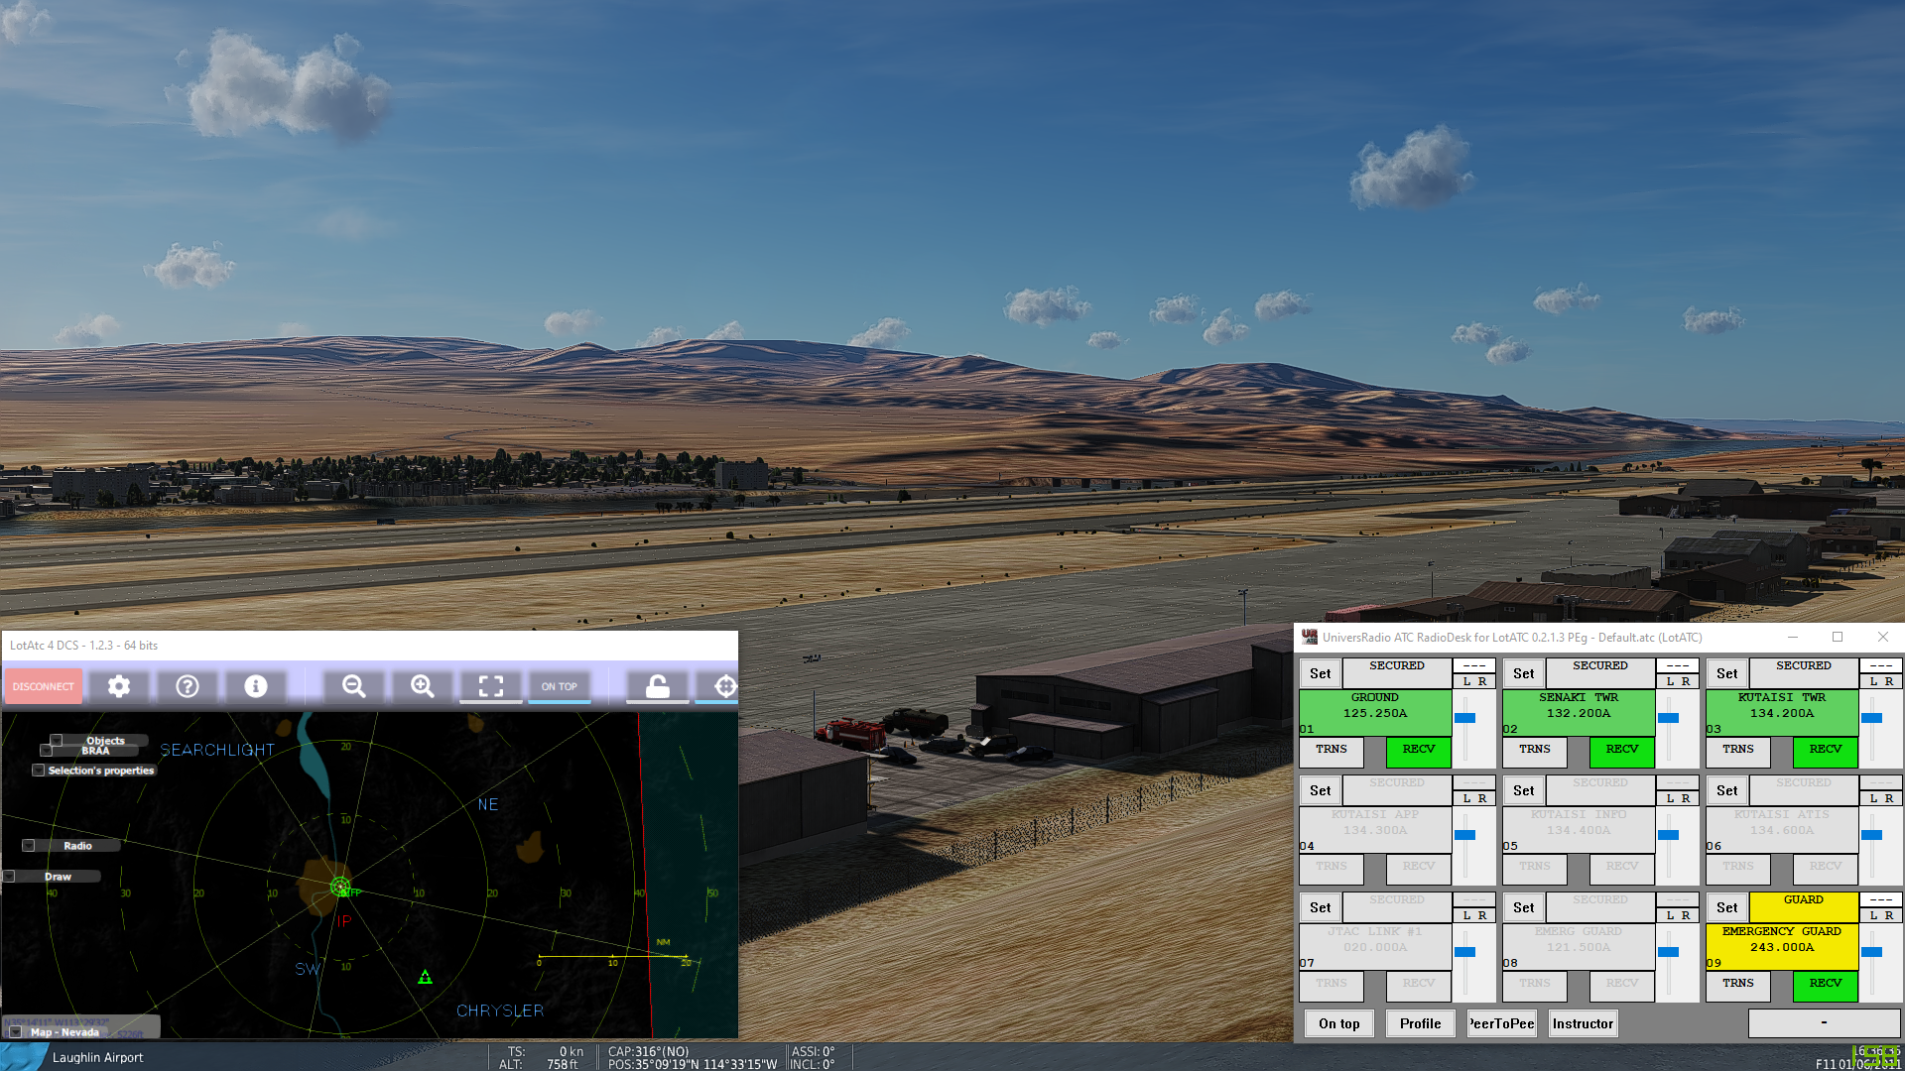

Slide 21
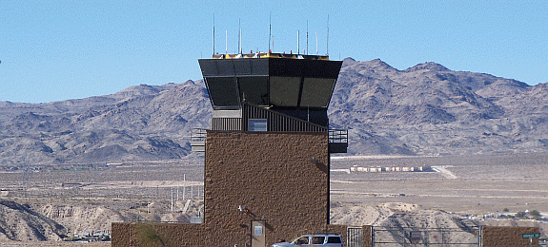
Questions?

Slide 22
