Slide 1
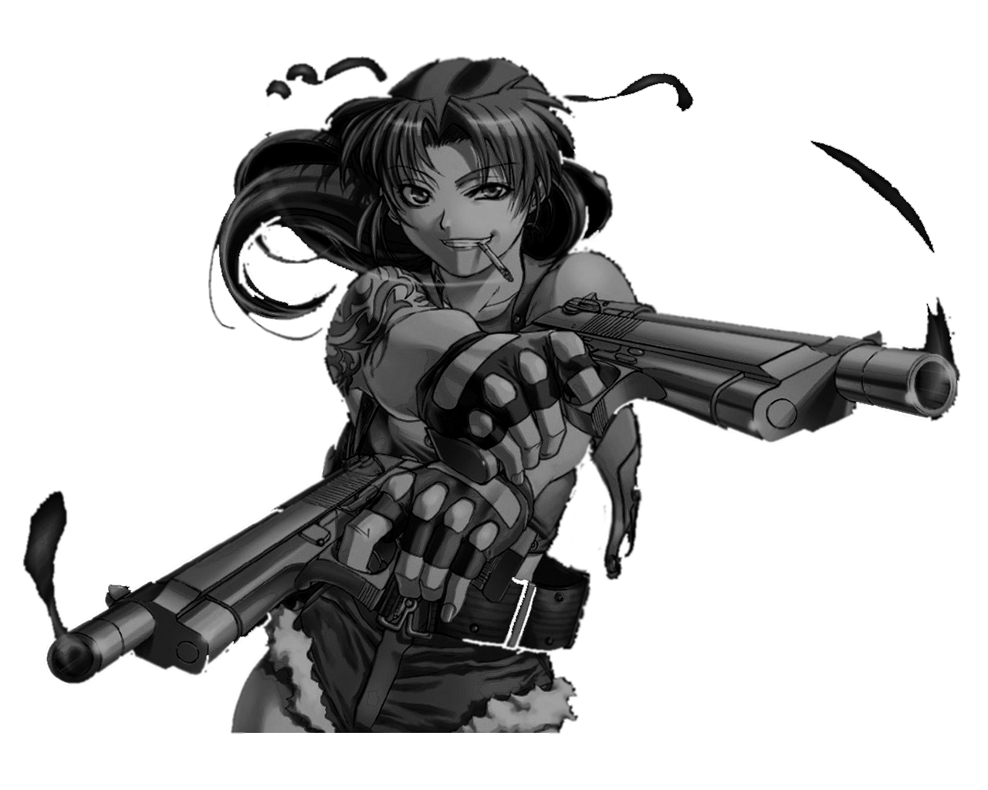
Jour 3 / Mission 10
LAN XV

Slide 2
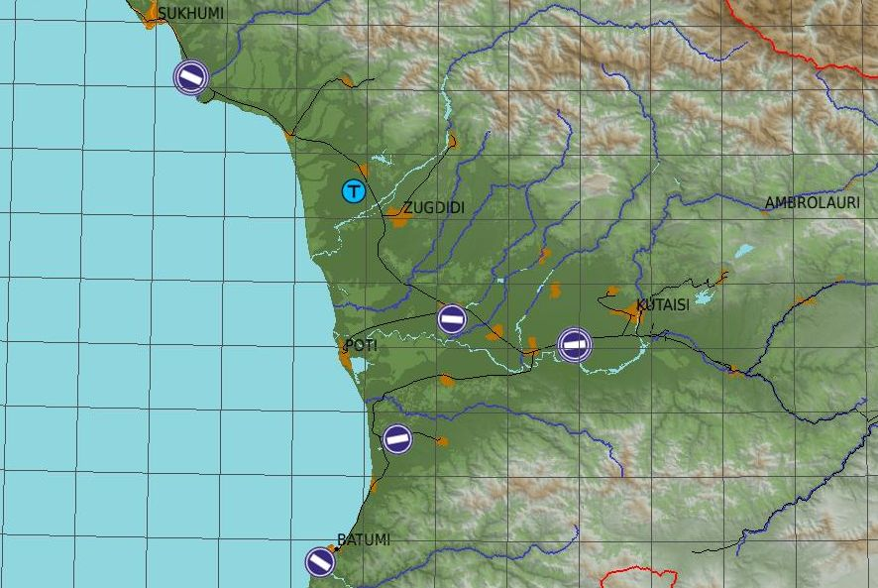
SITAC
SIDA
ZONE 0
ZONE 1
ZONE 2
ZONE 3

Slide 3
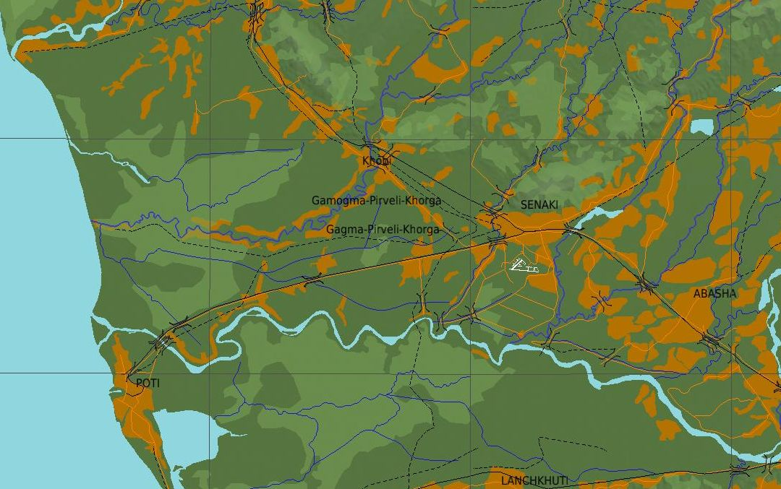
SITAC
ZONE 0 ET 1

Slide 4
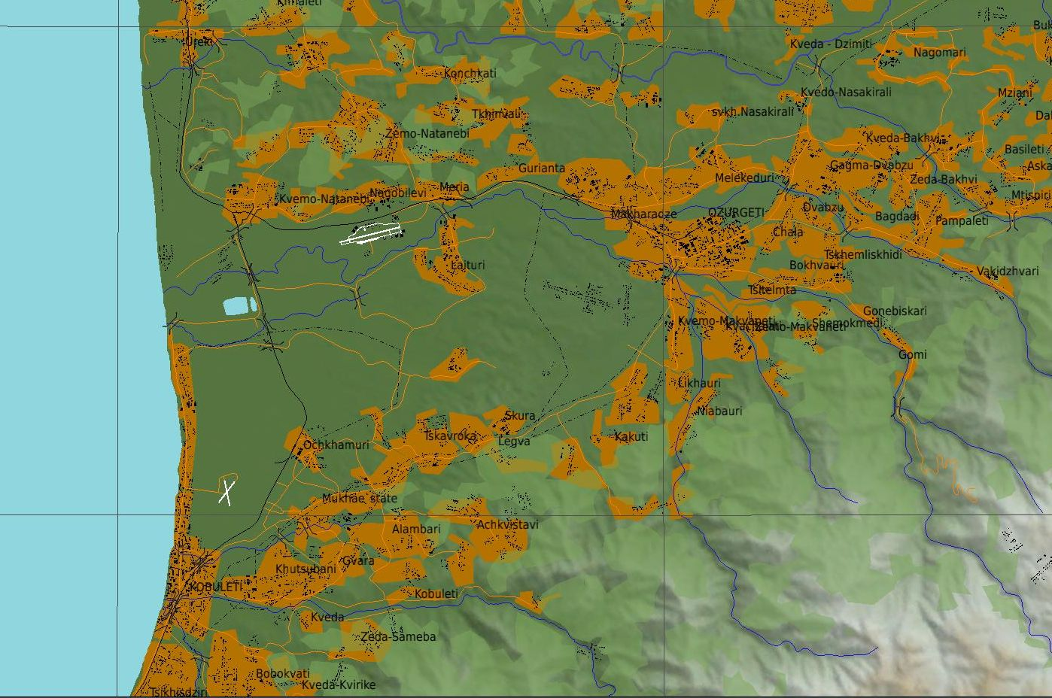
SITAC
ZONE 1 ET 2
Kobuleti apt
41°56’11’’N, 41°53’58’’
Makharadze
41°56’6’’N, 41°59’6’’
Ozurgeti
41°54’58’’N, 42°0’17’’
Gomi
41°52’12’’N, 42°6’26’’
FARP

Slide 5
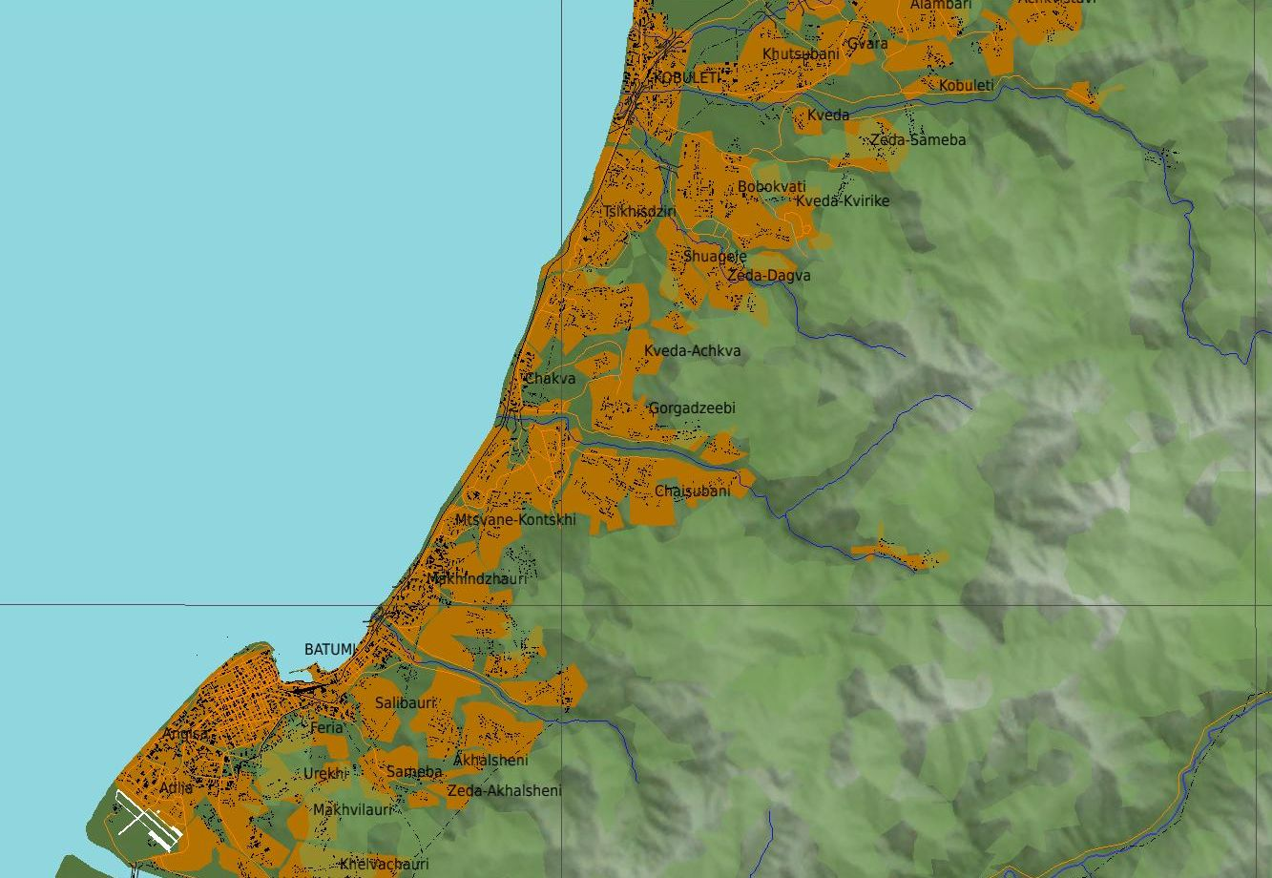
SITAC
ZONE 2 ET 3

Slide 6
LAN XV
MERCI ET BONNE CHASSE

